Slide 1
Red Stripe Football Fantasy League Application

Slide 2
Introduction
The Red Stripe Premier League is the biggest football league in Jamaica. However, it is not well publicized across Jamaica or the Caribbean. Therefore, it is not maximizing its audience which affects different areas in the league. Also, Individuals are not able to access up to date information on scores, matches and breaking news easily which leave the fans disengaged. Therefore, there is a lack of awareness, knowledge and exposure of the league. Having this application will aid in improving these areas.

Slide 3
Being football enthusiasts, the group wanted to develop an app that would be fun , interesting and geared toward the development of Jamaican football. Fantasy football games are becoming more popular with several games being developed for different leagues around the world. Therefore, it would be a great opportunity to bring an application to Jamaica’s biggest league. We believe it will be an exciting, educational and enlightening experience for users and players in Jamaica.

Slide 4
Scope
The football fantasy league app will be a web application for the local Red Stripe Premier League. Users will only be allowed to select 1 team with 11 players with 3 bench players from a list of all the players participating in the league. The user can select among 3 formations which will dictate how they choose their players. Depending on the formation, users can select a certain amount of Goal Keepers, Midfielders, Defenders and Strikers.The balance given will be a fixed $1 million JMD on sign up. Players will be priced differently depending on how good they are and popularity. Once the player’s score are updated the users scores will be adjusted.

Slide 5
Aim and Objectives
To create an account
Allowing users to choose between three different formations.
To purchase players for your team
To view league table
To view total and weekly scores
To allow users to transfer and substitute players
To have an attractive and user friendly interface for ease of use
To provide an interactive fantasy premier league for Jamaica
To give the students of UWI an opportunity to interact with the UWI football team
To provide exposure for the local Red Stripe Premier League

Slide 6
Diagrams

Slide 7
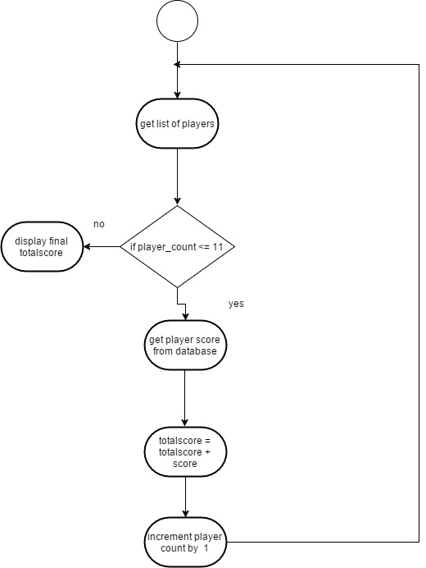
Activity Diagrams -Calculating Total User Score

Slide 8
Accomplishment
Over the three months period we have accomplished most of the key functionalities of the Red Stripe football application which are located in aim and objectives.
Being football enthusiasts, the group is pleased in creating this application to be an exciting, educational and enlightening experience for users and players in Jamaica

Slide 9
Some Functions
Sign Up/Login/Logout
Select players
Select formation
View ranks
View league table
View matches
View countdown to next match
View scores and balance
Transfer and substitute players

Slide 10
Not Accomplished
Forum
Live News
Admin
Web crawling scores (and news)

Slide 11
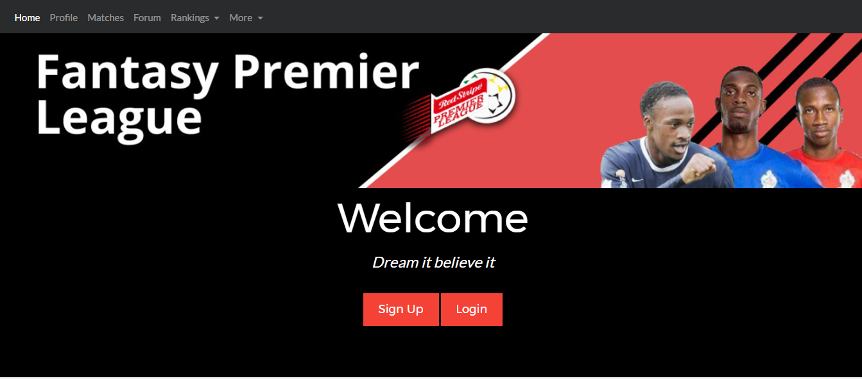
Screenshots

Slide 12
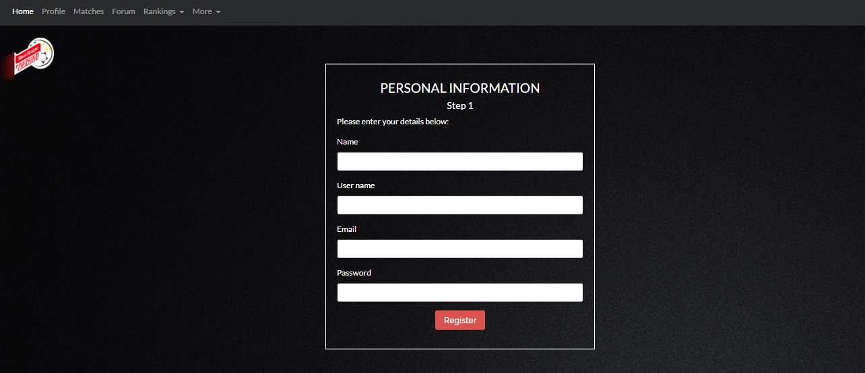
USER REGISTRATION

Slide 13
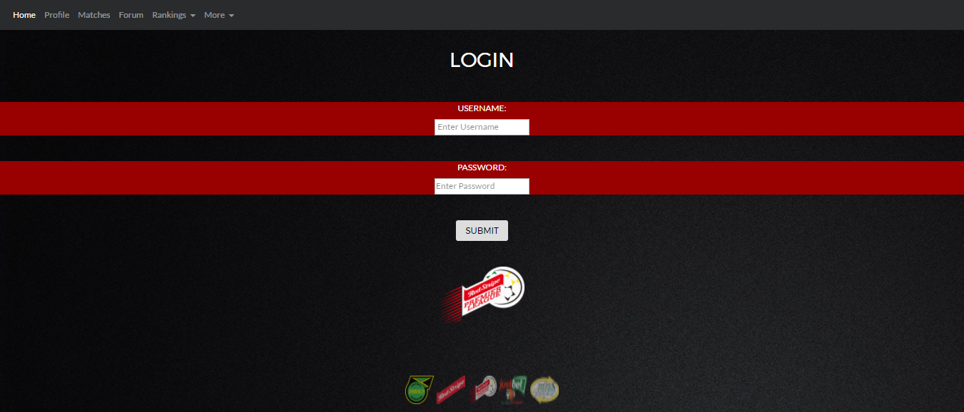
LOGIN FORM

Slide 14
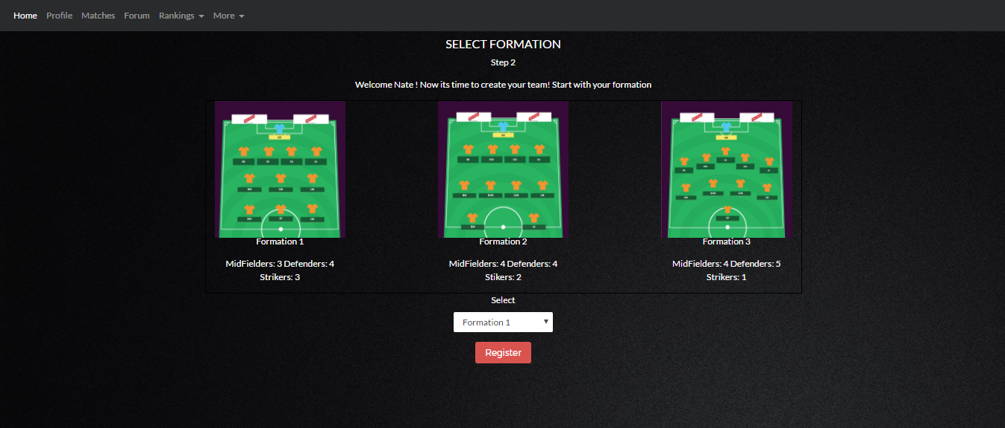
Selecting Formation

Slide 15
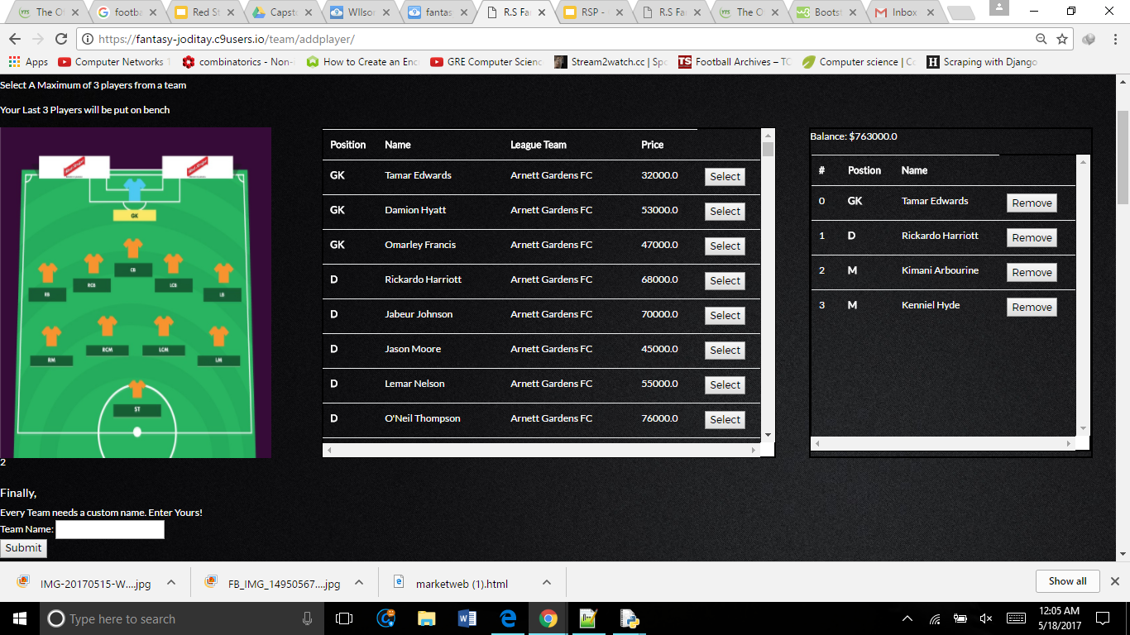
Selecting Players

Slide 16
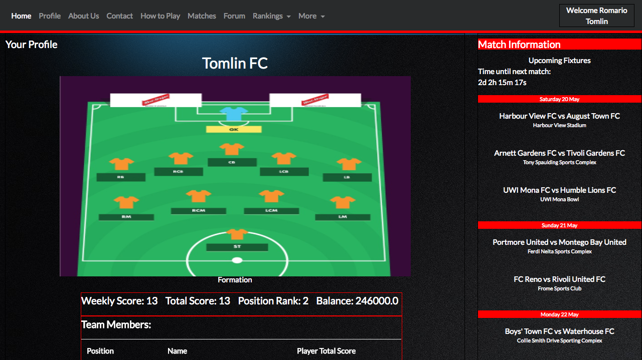
USER PROFILE

Slide 17
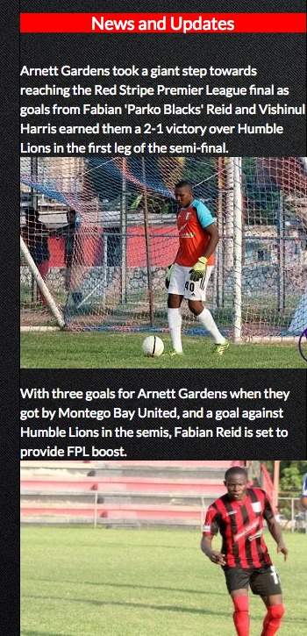
NEWS AND UPDATES

Slide 18
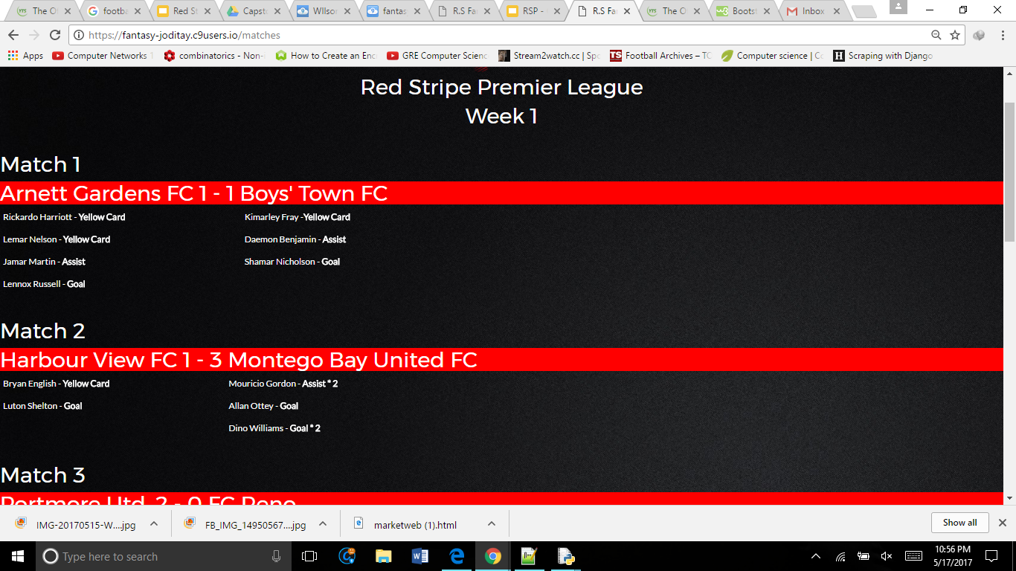
MATCHES

Slide 19
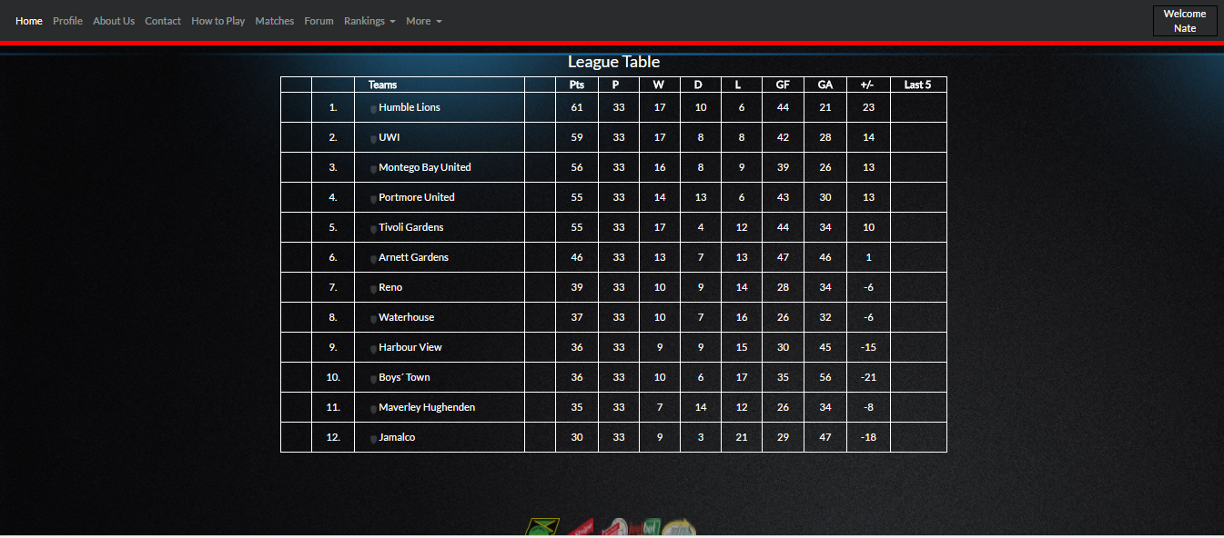
League Table

Slide 20
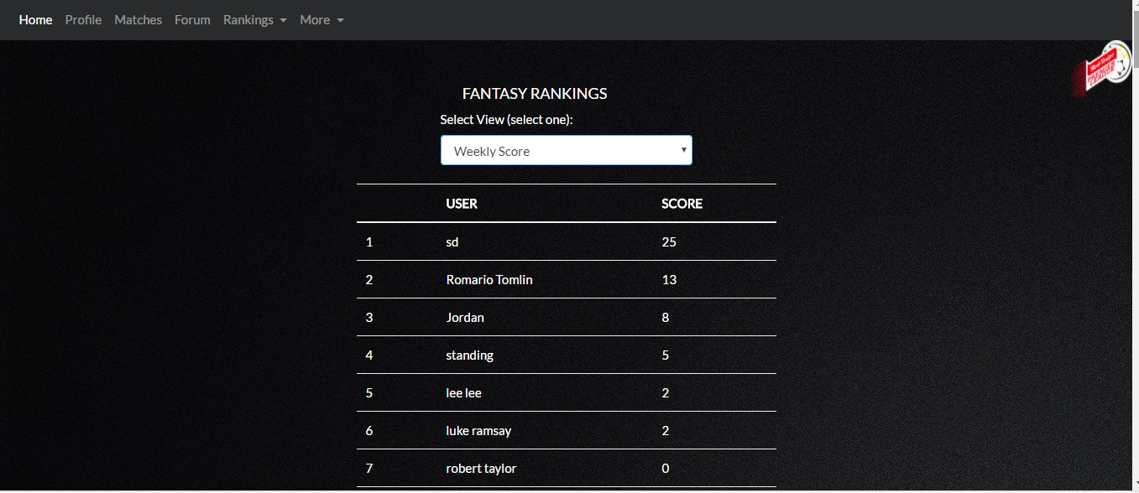
Player Rankings

Slide 21
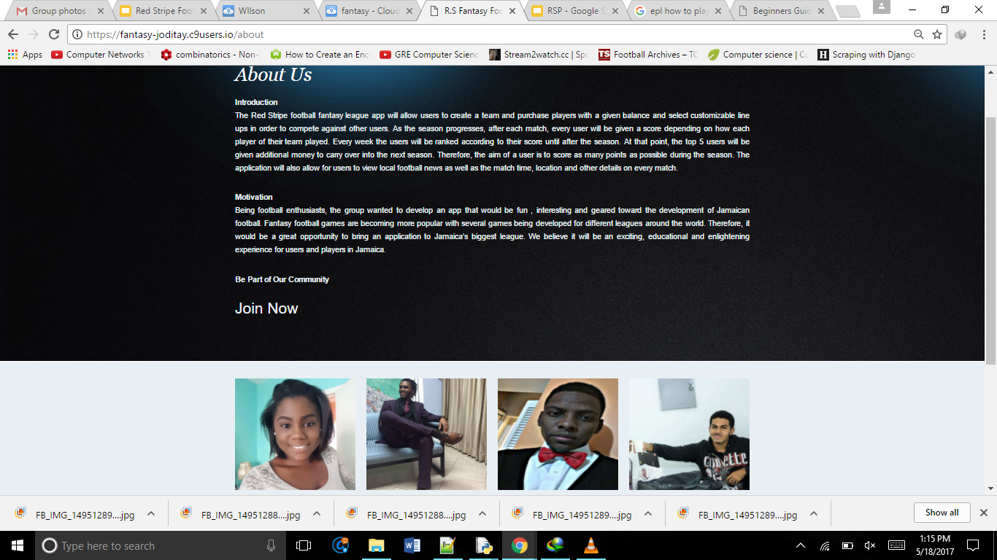
Marketing Page

Slide 22
Future Improvements

Slide 23
QUESTIONS

